Slide 1

CS-401
Computer Architecture & Assembly Language Programming
Lectures 39
Protected Mode Programming

Slide 2
CS-401
Computer Architecture & Assembly Language Programming
Lectures 40
Protected Mode Programming

Slide 3
CS-401
Computer Architecture & Assembly Language Programming
Lectures 41
Protected Mode Programming

Slide 4
CS-401
Computer Architecture & Assembly Language Programming
Lectures 42
Protected Mode Programming

Slide 5
CS-401
Computer Architecture & Assembly Language Programming
Lectures 43
Protected Mode Programming

Slide 6
CS-401
Computer Architecture & Assembly Language Programming
Lectures 44
Protected Mode Programming

Slide 7
CS-401
Computer Architecture & Assembly Language Programming
Lectures 45
Protected Mode Programming

Slide 8
In today’s lecture we will discuss advanced processors architecture

Slide 9

Lets revise the last lecture

Slide 10
Protected mode detail in INTEL processor

Slide 11
Reserved Interrupts for INTEL

Slide 12
Double Fault

Slide 13
Interrupt Gate Descriptor

Slide 14
Protective Mode

Slide 15
Descriptor/Global Descriptor Table

Slide 16
Descriptor tables

Slide 17
Types of descriptor tables

Slide 18
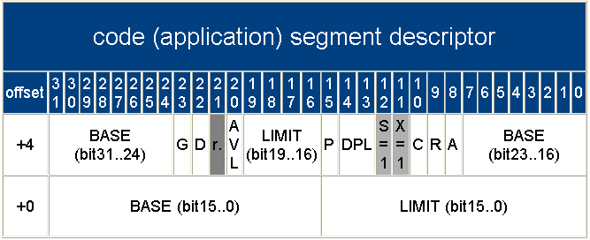
Code Segment Descriptor

Slide 19
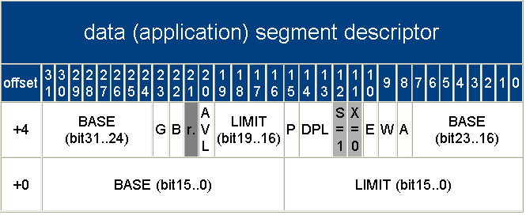
Data Segment Descriptor

Slide 20
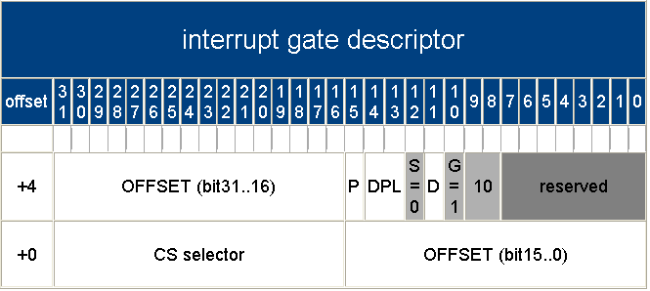
Interrupt Gate Descriptor

Slide 21
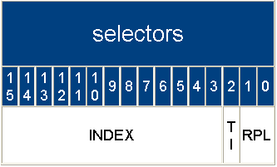
Selector

Slide 22
Control Register
req
31
30
29
19-28
18
17
16
6-15
5
4
3
2
1
0
CR0
P
G
C
D
N
W
reserved
A
M
R
W
P
reserved
W
E
E
T
T
S
E
M
M
P
P
K

Slide 23
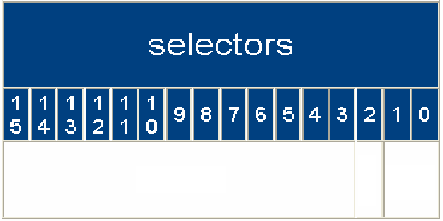


Selector
0x08
Index = 0x01 TI = 0 RPL = 00

Slide 24
Selector
0x10
Index = 0x02 TI = 0 RPL = 00

Slide 25
Descriptors
12
11
10
9
8
12
11
10
9
8
12
11
10
9
8
S=
1
X=
1
C
R
A
S=
0
Type
S=
1
X=
0
E
W
A

Slide 26
Video graphics and its formation

Slide 27
Int 0x10 VISA Services
Service 0x4F
Sub Service
0- Get SuperVGA Information
1- Get SuperVGA Mode Information
2- Set SuperVGA Video Mode

Slide 28
Int 0x10 VISA Services
Service 0x4F
AL = 0x00
ES:DI = SuperVGA information pointer
Return
AL = 0x4F if function supported
AH = status
0x00 = successful
0x01 = failed
0x02 = function not supported
0x03 = function invalid

Slide 29
Int 0x10 VISA Services
Service 0x4F
AL = 0x01
CX = SuperVGA mode
ES:DI = 256 byte buffer for mode information
Return
AL = 0x4F if function supported
AH = 0x00 successful
ES:DI = buffer filled
AH = 0x01 failed

Slide 30
Int 0x10 VISA Services
Service 0x4F
AL = 0x02
BX = new video mode
Return
AL = 0x4F if function supported
AH = status
0x00 = successful
0x01 = failed

Slide 31
Int 0x10 VISA Services
Service 0x4F
Video mode 0x8117
1024x768 and 64K colors with linear frame buffer
16 bits per pixel with 5:6:5 format
5 bits for red
6 bits for green
5 bits foe green
Linear frame buffer address at offset 0x28 of mode information buffer

Slide 32
Assignment for the students

Slide 33
Trap
Address
****
****
****
****
****
Instruction
**************
**************
**************
**************
**************
Service Routine
stack

Slide 34
Trap
Address
****
****
****
****
****
Instruction
**************
**************
**************
**************
**************
Service Routine
stack

Slide 35
Trap
Address
****
****
****
****
****
Instruction
**************
**************
**************
**************
**************
Service Routine
stack

Slide 36
Trap
Address
****
****
****
****
****
Instruction
**************
**************
**************
**************
**************
Service Routine
stack

Slide 37
Trap
Address
****
****
****
****
****
Instruction
**************
**************
**************
**************
**************
Service Routine
stack

Slide 38
Fault
Address
****
****
****
****
****
Instruction
**************
**************
**************
**************
**************
Service Routine
stack

Slide 39
Fault
Address
****
****
****
****
****
Instruction
**************
**************
**************
**************
**************
Service Routine
stack

Slide 40
Fault
Address
****
****
****
****
****
Instruction
**************
**************
**************
**************
**************
Service Routine
stack

Slide 41
Fault
Address
****
****
****
****
****
Instruction
**************
**************
**************
**************
**************
Service Routine
stack

Slide 42
Fault
Address
****
****
****
****
****
Instruction
**************
**************
**************
**************
**************
Service Routine
stack

Slide 43
Abort
Address
****
****
****
****
****
Instruction
**************
**************
**************
**************
**************
Service Routine
stack

Slide 44
Abort
Address
****
****
****
****
****
Instruction
**************
**************
**************
**************
**************
Service Routine
stack

Slide 45
Abort
Address
****
****
****
****
****
Instruction
**************
**************
**************
**************
**************
Service Routine
stack

Slide 46
Abort
Address
****
****
****
****
****
Instruction
**************
**************
**************
**************
**************
Service Routine
stack

Slide 47
Protected Mode Interrupts
Interrupt # Instruction Type
Divide error 0 DIV/IDIV Fault
Debug Exception 1 any inst. Trap
NMI Interrupt 2 INT 2/NMI NMI
One byte interrupt 3 INT Trap
Interrupt overflow 4 INT 0 Trap
Array bound check 5 BOUND Fault
Invalid opcode 6 Illegal Inst. Fault
Device not available 7 ESC/WAIT Fault
Double fault 8 Inst. Which Abort
generate exception

Slide 48
Protected Mode Interrupts
Interrupt # Instruction Type
Intel reserved 9
Invalid TSS 10 JMP/CALL/IRET/INT Fault
Segment not present 11 seg. Reg. inst. Fault
Stack fault 12 Stack ref. Fault
General protection Fault13 Mem. Ref. Fault
Page fault 14 Mem. Access/ Fault
code fetch
Coprocessor error 16 ESC/WAIT Fault
Intel reserved 17-32
Two byte interrupt 33-255 INT Trap

